Slide 1

Airline Survival Comparisons over 100 years
Taylor kerns, Joshua Robles
and Kiele Allen

Slide 2
We believe the data will prove that it was safer to fly towards the end of the century (2015) rather than the beginning (1915).
Hypothesis

Slide 3
In what ways has air industry safety changed from 1915-2015? In what ways has air industry safety appear the same? How has likelihood of survival of a plane crash has changed? Which plane types have are frequently involved in crashes?
Our Questions

Slide 4
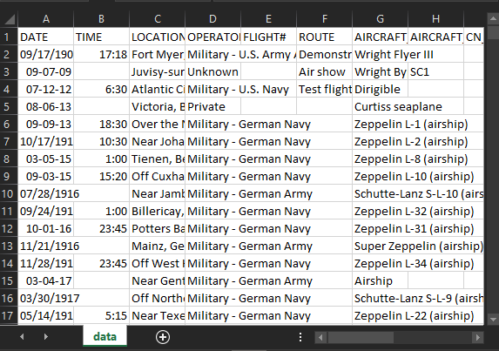


Data Clean-Up & Exploration
Removes irrelevant columns from df
Removes blanks in df and replaces with “0”
Notes:
Open Jupyter Notebook

Slide 5
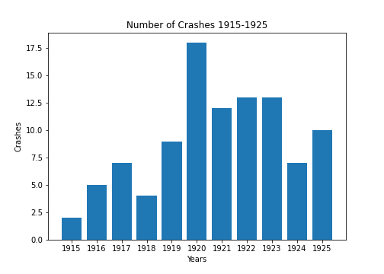
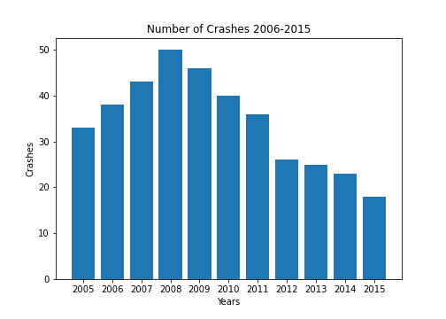
In what ways has air industry safety changed from 1915-2015? In what ways has air industry safety appear the same?
Notes:
Include: # of flights (commercial/private/cargo) difference between the two timeframes (flights per yr: 1915 = , 2015 = 34 million, 2021 = ~ 100,00 flights per day), include the influence of combat via aviation, frequency of flights.
History during 1915-1925: First aviation flight: December 17, 1903

Slide 6
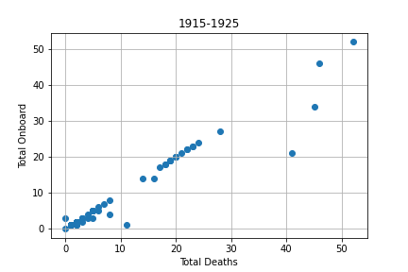
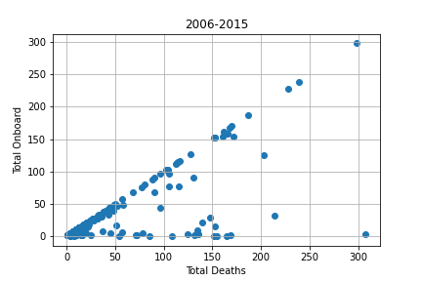
How has likelihood of survival of a plane crash has changed?

Slide 7
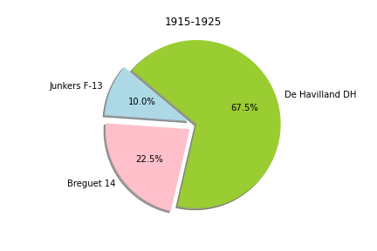
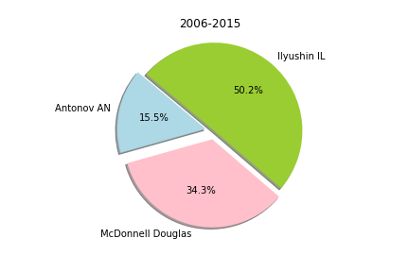
Which plane types have been frequently involved in crashes?
Notes:
Bregue-14 & De Vavilland DH-4 were bomber planes in WWI. Junkers F-13 was a small passenger plane.
Antonov AN is cargo air craft
, McDonnell Douglas is a single aisle passenger carrier

Slide 8
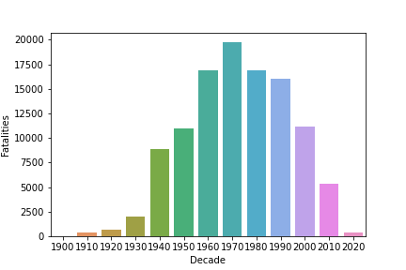
Our hypothesis was inconclusive. While the data supports improvements in the overall probability of surviving a plane crash, other factors need to be represented in order to support our hypothesis.
Notes:
Final Analysis & conclusions- Joshua’s overall Pie Chart
Technically there are more crashes BUT there are more flights. Likelihood of survival is higher based off the scatter plots for Q2.

Slide 9
Questions?
Open discussion

Slide 10
-https://www.kaggle.com/saurograndi/airplane-crashes-since-1908 -https://www.bts.gov/content/us-air-carrier-safety-data
Sources

